Slide 1

Hybrid Mobile App Development with the Salesforce Mobile SDK
Fulfilling custom offline use cases, delivering unique user experiences, and quenching your thirst for writing code

Slide 2
Forward-Looking Statements
Statement under the Private Securities Litigation Reform Act of 1995:
This website and other items we publish, including through social media outlets, may contain forward-looking statements, the achievement or success of which involves risks, uncertainties, and assumptions. If any such risks or uncertainties materialize or if any of the assumptions proves incorrect, the results of salesforce.com, inc. could differ materially from the results expressed or implied by the forward-looking statements we make.
The risks and uncertainties referred to above include – but are not limited to – risks associated with possible fluctuations in our financial and operating results; our rate of growth and anticipated revenue run rate, including our ability to convert deferred revenue and unbilled deferred revenue into revenue and, as appropriate, cash flow, and our ability to grow deferred revenue and unbilled deferred revenue; errors, interruptions or delays in our service or Web hosting; breaches of our security measures; the financial impact of any previous and future acquisitions; the nature of our business model; our ability to continue to release, and gain customer acceptance of, new and improved versions of our service; successful customer deployment and utilization of our existing and future services; changes in our sales cycle; competition; various financial aspects of our subscription model; unexpected increases in attrition or decreases in new business; our ability to realize benefits from strategic partnerships; reliance on third-party computer hardware and software; the emerging markets in which we operate; unique aspects of entering or expanding in international markets; our ability to hire, retain and motivate employees and manage our growth; changes in our customer base; technological developments; regulatory developments; litigation related to intellectual property and other matters, and any related claims, negotiations and settlements; unanticipated changes in our effective tax rate; factors affecting our outstanding convertible notes and credit facility; fluctuations in the number of shares we have outstanding and the price of such shares; foreign currency exchange rates; collection of receivables; interest rates; factors affecting our deferred tax assets and ability to value and utilize them, including the timing of achieving profitability on a pre-tax basis; the potential negative impact of indirect tax exposure; the risks and expenses associated with our real estate and office facilities space; and general developments in the economy, financial markets, and credit markets.
Further information on these and other factors that could affect the financial results of salesforce.com, inc. is included in the reports on Forms 10-K, 10-Q and 8-K and in other filings we make with the Securities and Exchange Commission from time to time, including our most recent Form 10-K. These documents are available on the SEC Filings section of the Investor Information section of our website at www.salesforce.com/investor.
Any unreleased services or features referenced in this or other presentations, press releases or public statements are not currently available and may not be delivered on time or at all. Customers who purchase our services should make their purchase decisions based upon features that are currently available.

Slide 3
Forward-Looking Statements
A.K.A. Sand Harbor I Statement
Statement under the Private Securities Litigation Reform Act of 1995:
This website and other items we publish, including through social media outlets, may contain forward-looking statements, the achievement or success of which involves risks, uncertainties, and assumptions. If any such risks or uncertainties materialize or if any of the assumptions proves incorrect, the results of salesforce.com, inc. could differ materially from the results expressed or implied by the forward-looking statements we make.
The risks and uncertainties referred to above include – but are not limited to – risks associated with possible fluctuations in our financial and operating results; our rate of growth and anticipated revenue run rate, including our ability to convert deferred revenue and unbilled deferred revenue into revenue and, as appropriate, cash flow, and our ability to grow deferred revenue and unbilled deferred revenue; errors, interruptions or delays in our service or Web hosting; breaches of our security measures; the financial impact of any previous and future acquisitions; the nature of our business model; our ability to continue to release, and gain customer acceptance of, new and improved versions of our service; successful customer deployment and utilization of our existing and future services; changes in our sales cycle; competition; various financial aspects of our subscription model; unexpected increases in attrition or decreases in new business; our ability to realize benefits from strategic partnerships; reliance on third-party computer hardware and software; the emerging markets in which we operate; unique aspects of entering or expanding in international markets; our ability to hire, retain and motivate employees and manage our growth; changes in our customer base; technological developments; regulatory developments; litigation related to intellectual property and other matters, and any related claims, negotiations and settlements; unanticipated changes in our effective tax rate; factors affecting our outstanding convertible notes and credit facility; fluctuations in the number of shares we have outstanding and the price of such shares; foreign currency exchange rates; collection of receivables; interest rates; factors affecting our deferred tax assets and ability to value and utilize them, including the timing of achieving profitability on a pre-tax basis; the potential negative impact of indirect tax exposure; the risks and expenses associated with our real estate and office facilities space; and general developments in the economy, financial markets, and credit markets.
Further information on these and other factors that could affect the financial results of salesforce.com, inc. is included in the reports on Forms 10-K, 10-Q and 8-K and in other filings we make with the Securities and Exchange Commission from time to time, including our most recent Form 10-K. These documents are available on the SEC Filings section of the Investor Information section of our website at www.salesforce.com/investor.
Any unreleased services or features referenced in this or other presentations, press releases or public statements are not currently available and may not be delivered on time or at all. Customers who purchase our services should make their purchase decisions based upon features that are currently available.

Slide 4

Self-Aggrandizement
Nathan Pepper
Lead Technical Consultant, Perficient
Founder/Organizer, Los Angeles Salesforce Developer Group
My Story
UCLA, B.S. Cognitive Science -> 2008
Excel temp -> 2008-2009
VBA programmer (“Excel guy”) -> 2009-2010
Data person (Salesforce analyst?) -> 2010-2011
Salesforce admin -> 2011-2012
Salesforce developer -> 2012-Present

Slide 5
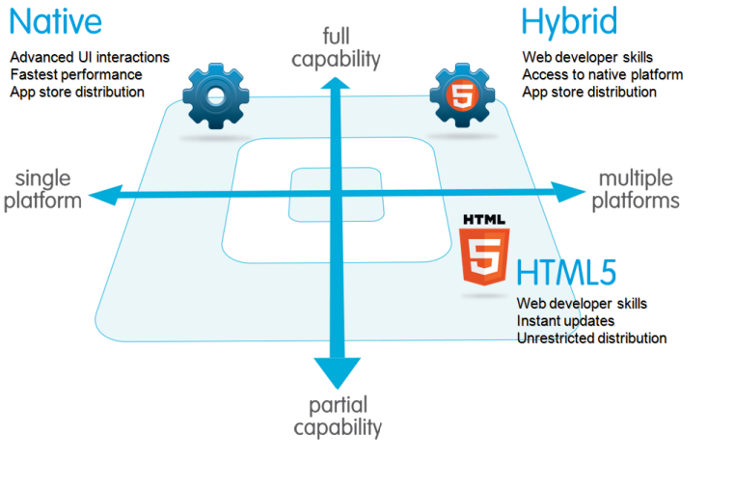
To Native or To Hybrid?
Native - Swift/ObjC, Java, C++... Direct3D?
HTML5 - Web App (think Bookmark)
Hybrid - HTML/CSS/JS packaged into a device app

Slide 6
To Native or To Hybrid?
Native - Swift/ObjC, Java, C++... Direct3D?
HTML5 - Web App (think Bookmark)
Hybrid - HTML/CSS/JS packaged into a device app
What’s in the lower left?

Slide 7
To Native or To Hybrid?
Native - Swift/ObjC, Java, C++... Direct3D?
HTML5 - Web App (think Bookmark)
Hybrid - HTML/CSS/JS packaged into a device app
What’s in the lower left?
Nothing ¯\_(ツ)_/¯

Slide 8
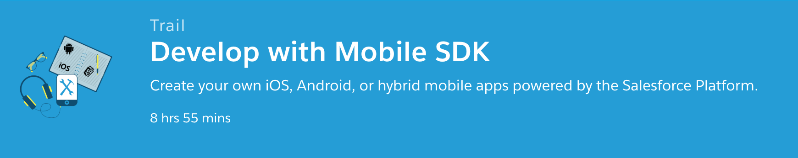
So, how do I start?
pretty much
https://trailhead.salesforce.com/trails/mobile_sdk_intro

Slide 9

Install Common Components
Get node
https://nodejs.org
This comes with npm (node package manager)

Slide 10

Install Common Components
Get git
https://git-scm.com

Slide 11
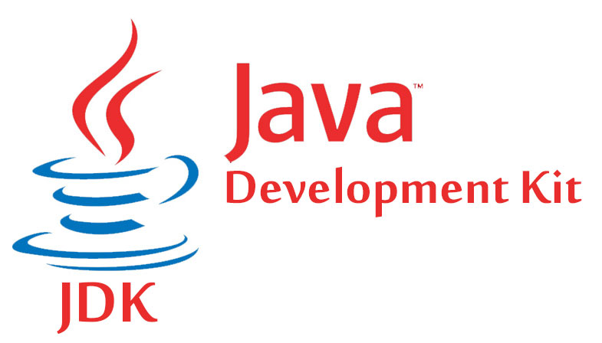
Setup Your Android Dev Environ
Install JDK
https://www.oracle.com/java/index.html

Slide 12

Setup Your Android Dev Environ
Install Android Studio
https://developer.android.com/studio/index.html

Slide 13

Setup Your Android Dev Environ
Install forcedroid
https://www.npmjs.com/package/forcedroid
> npm install -g forcedroid
Nope.
> sudo npm install -g forcedroid
yes master
> |

Slide 14

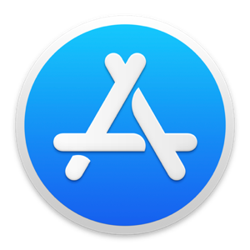
Setup Your iOS Dev Environment
Install Xcode
From the App Store

Slide 15
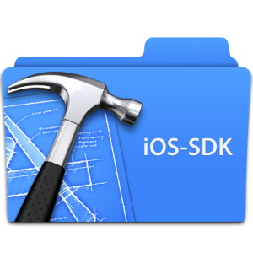
Setup Your iOS Dev Environment
Install extra Xcode stuff
This includes the iOS 10 SDK

Slide 16

Setup Your iOS Dev Environment
Install Cocoapods

Slide 17
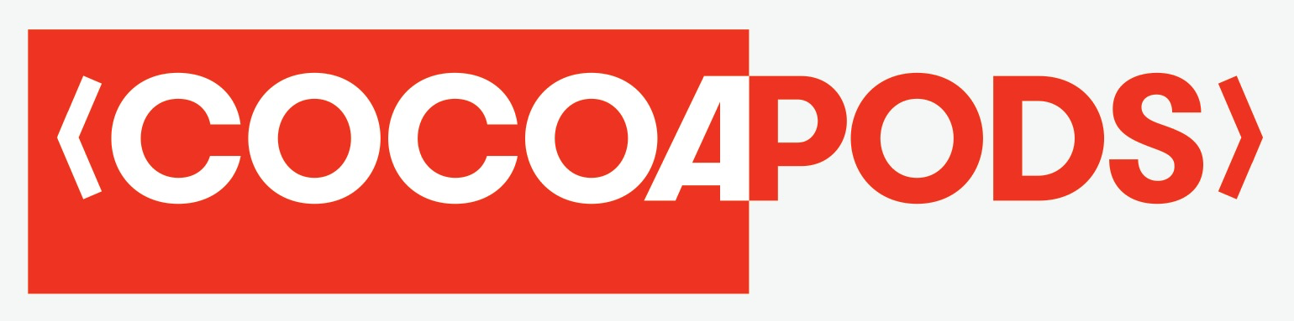
Setup Your iOS Dev Environment
Install Cocoapods
(it’s a Ruby thing)
> sudo gem install cocoapods
Dependency manager for Swift and Objective-C Cocoa projects.

Slide 18
Setup Your iOS Dev Environment
Install forceios
> sudo npm install -g forceios

Slide 19
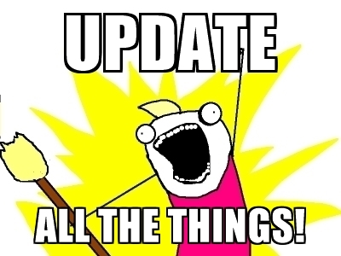
Start With The Most Recent
Get the most up-to-date versions of everything:
git
node/npm
n? (node version manager)
Cordova
ALL THE THINGS!

Slide 20
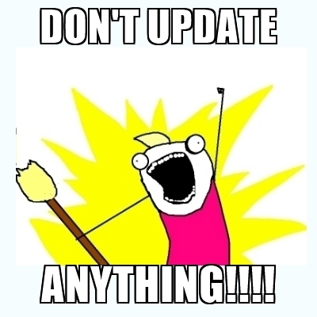
Then… DO NOT UPDATE!!!
You: “But what if it’s totally unrelated to mobile development?” Me: “No.”
You: “But it’s a security patch for my OS…” Me: “Definitely no!”

Slide 21
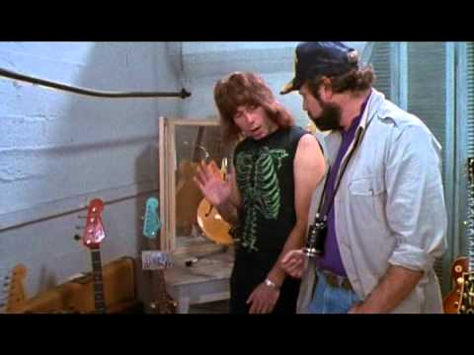
Then… DO NOT UPDATE!!!
You: “But what if it’s totally unrelated to mobile development?” Me: “No.”
You: “But it’s a security patch for my OS…” Me: “Definitely no!”
You: “Can I point at it?” Me: “Nope.”

Slide 22

Then… DO NOT UPDATE!!!
You: “But what if it’s totally unrelated to mobile development?” Me: “No.”
You: “But it’s a security patch for my OS…” Me: “Definitely no!”
You: “But Ironhead, what’s with this thingy?” Me: “NOOOOOO!!!”

Slide 23
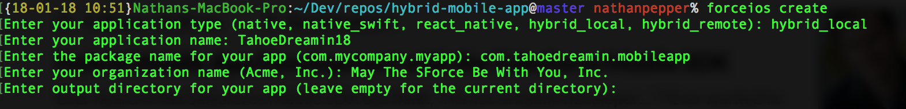
Let’s do it!!
Getting started: force[ios|droid] create
Doing this...

Slide 24
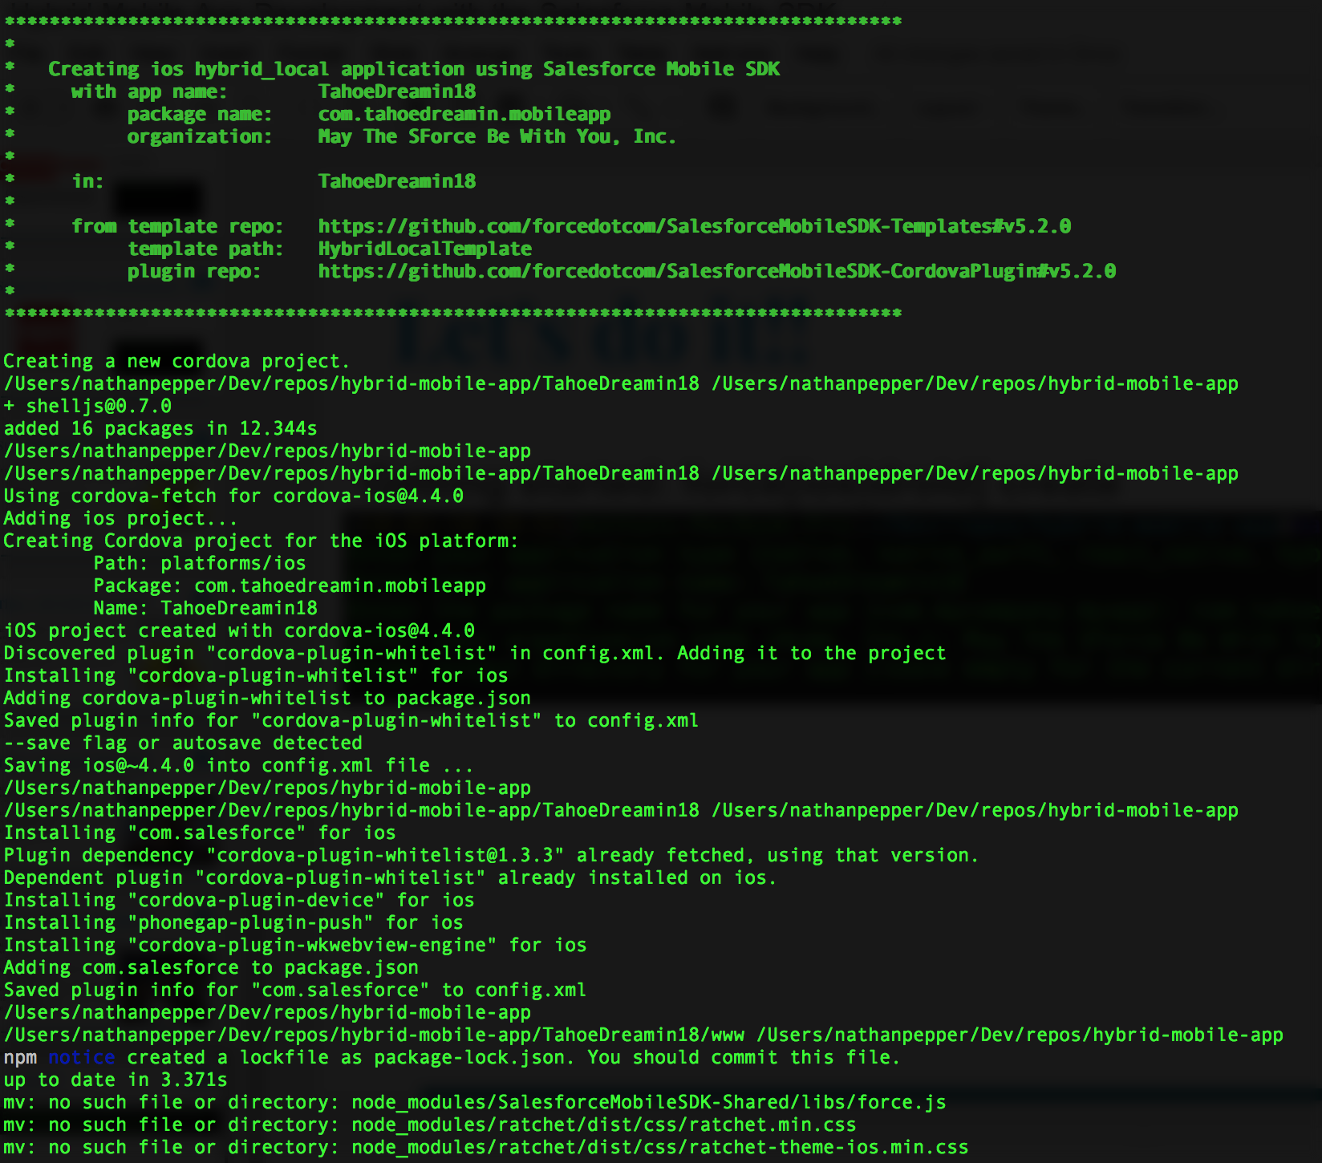
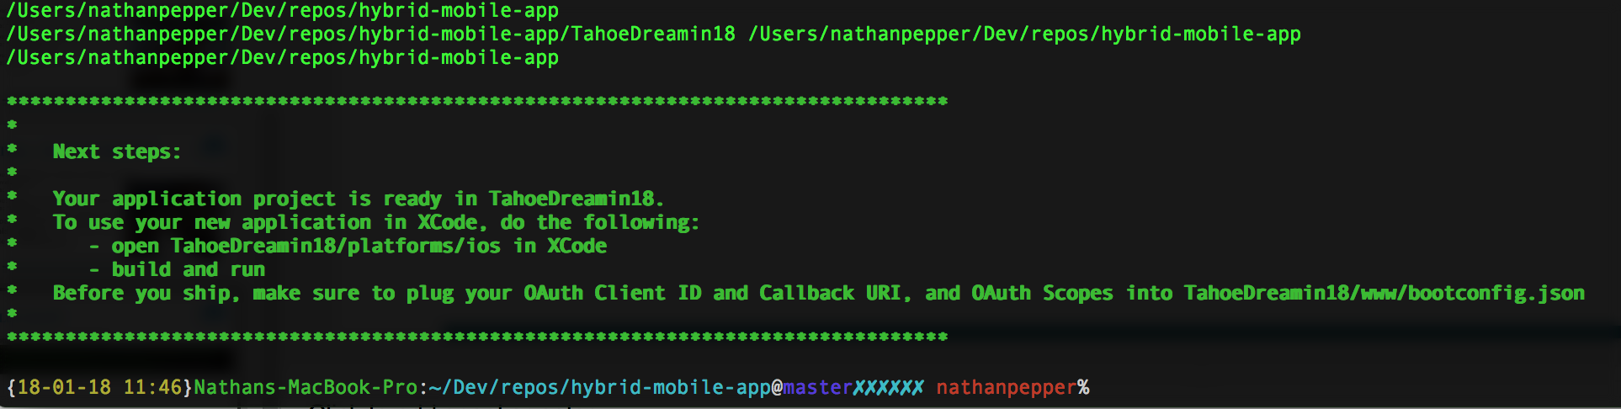
Let’s do it!!
Gets you this...

Slide 25
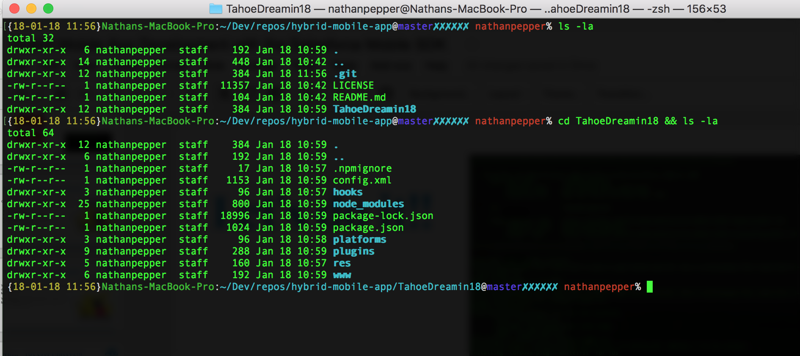
Let’s do it!!
Which results in this...

Slide 26


And now for some co(me)dy relief
https://github.com/TahoeDreamin2018/hybrid-mobile-app

Slide 27


SVG vs. Font Awesome
http://fontawesome.io

Slide 28
Q&A

